Slide 1
Digital Portfolio
STUDENT NAME: Kathirvel G
REGISTER NO AND NMID: astvu300tvu30030048010
DEPARTMENT: B.sc.Data Science
COLLEGE: Thiruvalluvar University

Slide 2
PROJECT TITLE
Digital Portfolio Using HTML,CSS ,
Java script

Slide 3


AGENDA
Problem Statement
Project Overview
End Users
Tools and Technologies
Portfolio design and Layout
Features and Functionality
Results and Screenshots
Conclusion
GitHub Link
3/21/2024 Annual Review

Slide 4

PROBLEM STATEMENT
Define the problem: Explain the need for a digital portfolio in today's digital age.
Why it's important: Address the gap for students, professionals, or businesses needing a modern, interactive way to showcase their work, skills, and accomplishments.

Slide 5

PROJECT OVERVIEW
Objective: To create a comprehensive, easy-to-navigate digital portfolio for individuals to showcase their work or achievements online.
Purpose: Helping users professionally present their projects, skills, and experiences in a dynamic way.
Scope: This digital portfolio includes sections for education, experience, skills, projects, and contact details, and it can be easily updated.

Slide 6

WHO ARE THE END USERS?
End Users: Students, professionals, job seekers, and freelancers.
Needs: A platform for individuals to showcase their personal projects, resumes, portfolios, and achievements to prospective employers or clients.
Pain Points: Traditional paper resumes and portfolios are static and don't offer interactivity or instant updates.

Slide 7

TOOLS AND TECHNIQUES
Frontend: HTML, CSS, JavaScript (for interactive features and layout).
Backend: [If applicable] Node.js, PHP, or any backend technology you used.
Other Tools: GitHub (for code versioning), design tools like Figma or Adobe XD (for UI design).

Slide 8
POTFOLIO DESIGN AND LAYOUT
> Section Included
> Home / About Me
> Projects
> Skills
> Contacts
> Responsive layout (mobile + desktop view)
8

Slide 9
FEATURES AND FUNCTIONALITY
Interactive Sections: Dynamic project showcases, downloadable resume, embedded video introductions, etc.
Customizable Design: Users can personalize their portfolios by adding content, changing themes, or updating sections.
Mobile-Friendly: Designed to be accessible on mobile devices for convenience.

Slide 10
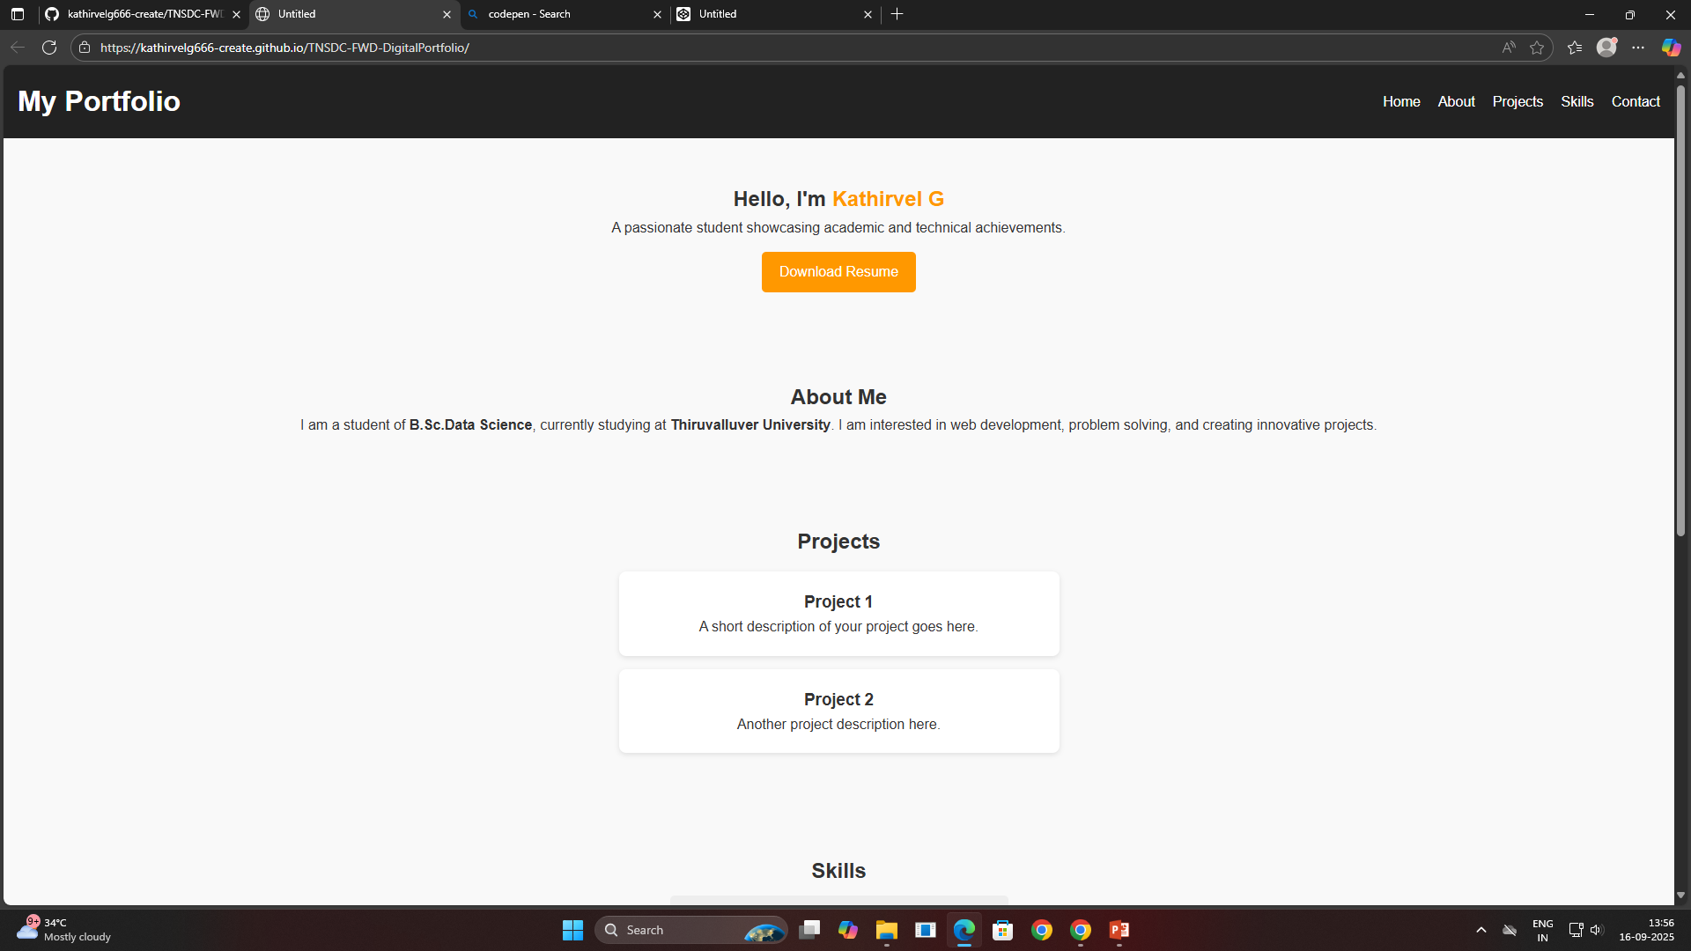


RESULTS AND SCREENSHOT 1
3/21/2024 Annual Review
10

Slide 11
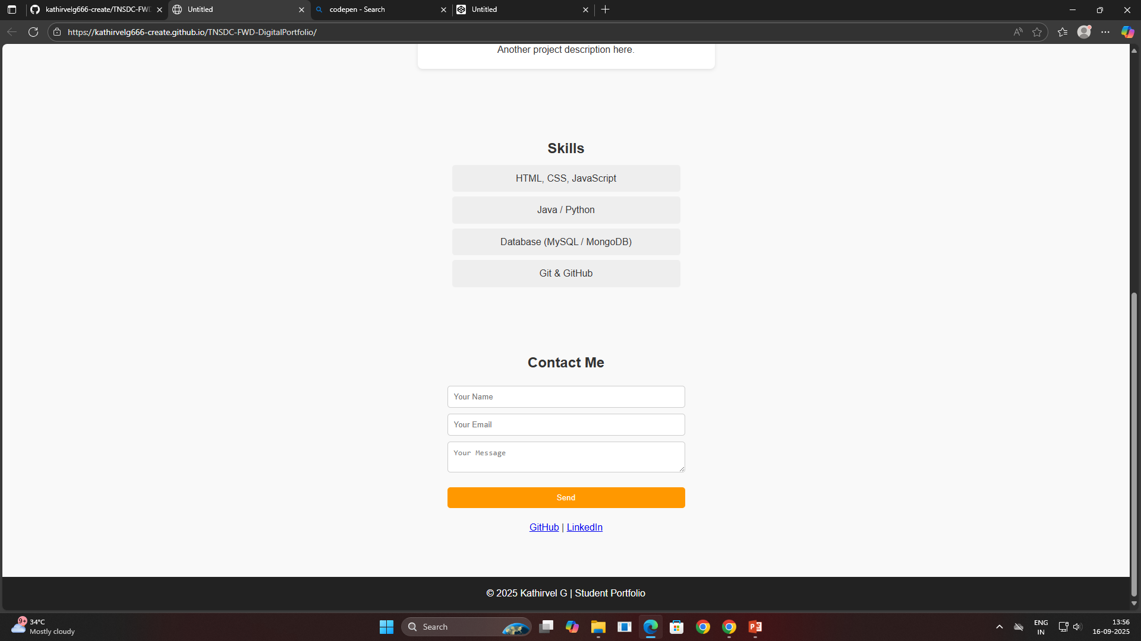

RESULT AND SCREENSHOT 2

Slide 12
CONCLUSION
Key Takeaways: Digital portfolios are a crucial tool for personal branding, offering a dynamic, interactive way to present achievements.
Future Improvements: Adding more interactive features, such as integrations with social media or work platforms, and expanding user customization options.
Impact: A digital portfolio enhances professional visibility and provides an organized, modern way to present one’s work.
12

Slide 13
GitHub Link : https://github.com/kathirvelg666-create/TNSDC-FWD-DigitalPortfolio.git

